Slide 1
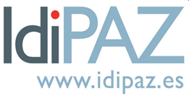
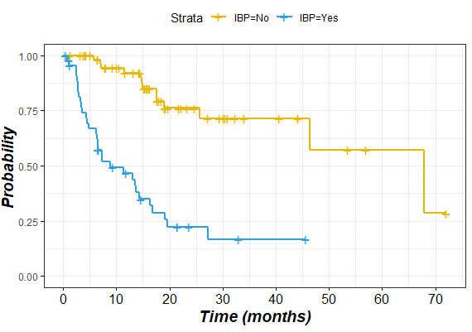
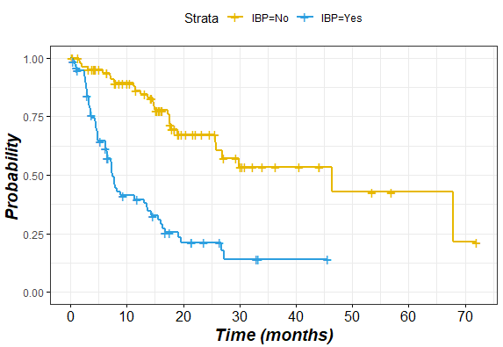
Concomitant administration of palbociclib and proton pump inhibitors affects clinical outcomes in metastatic breast cancer patients
243P
J. Álvarez Criado ¹, V. Martínez Marín², MP. Zamora Aunon², J. Pena López², VL. Collada Sánchez¹, E. Espinosa Arranz², A. Hoyo Munoz¹, L. García López¹, C. Mateos Salillas¹, D. Martínez Pérez², B. Castelo Fernández², I. Ruiz Gutiérrez², JA. García Cuesta², D. Jiménez Bou², S. Martínez Recio², J. Pedregosa Barbas², J. Feliú Battle², A. Herrero Ambrosio¹
¹ Servicio de Farmacia Hospitalaria, Hospital Universitario La Paz de Madrid; ² Servicio de Oncología Médica, Hospital Universitario La Paz de Madrid
BACKGROUND
Figure 1. Global PFS
Figure 2. PFS 1st line
Table 1. Clinical characteristics of patients
Clinical characteristics | Total number of patients (n = 169)
Age at the diagnosis of metastasis (years), median (range) | 62 (31-95)
Pre/postmenopause, n (%)
Premenopause | 26 (15.4)
Postmenopause | 143 (84.6)
ECOG, n (%)
0 | 67 (39.6)
1 | 85 (49.7)
2 | 2 (10.7)
Disease site, n (%)
Visceral | 117 (69.2)
Non-visceral | 52 (30.8)
First-line | 112(66.3)
Type of HT associated to palbociclib, n (%)
Fulvestrant | 77 (45.6)
Letrozole | 92 (54.4)
Dose reduction of palbociclib, n (%)
125 mg | 104 (61.5)
100 mg | 35 (20.7)
75 mg | 27 (17.8)
PPI used, n (%) | 80 (50.3)
First-line PPIs | 48 (42.9)
Second-line PPIs | 32 (56.1)
Omeprazole | 75 (93.8)
Other PPIs | 5 (6.2)
Cyclin-dependent kinase 4 and 6 (CDK4/6) inhibitors are usually combined with fulvestrant or aromatase inhibitors for the treatment of patients with metastatic breast cancer (mBC). Drug-drug interactions may affect absorption by different mechanims, for instance, modification of digestive pH. Proton pump inhibitors (PPIs) are known to reduce the oral bioavailability of some anticancer drugs.
Palbociclib is a weak base with pH-dependent solubility, therefore variations in gastric pH could affect its absorption. The objective of this study was to evaluate the interaction between PPIs and palbociclib by analizing progression-free survival (PFS) in patients with mBC.
METHODS
This is a retrospective study approved by the local Ethics Committee. Patients had received palbociclib between January 2016 and December 2021. The following variables were collected: age, menopausal status, performance status, hormonal treatment (fulvestrant or aromatase inhibitors), visceral or non-visceral disease, first-line vs second-line treatment, ki67, and concomitant concomitant use of PPIs.
PFS was defined as the time from starting treatment to progression of the disease. Survival was estimated with the Kaplan-Meier method, whereas Cox Regression models were used to estimate hazard ratios. The Mann-Whitney or Kruskal Wallis test were used to analyze continuous variables, and the chi-square test for categorical variables.
Table 2. Analysis for progression-free survival
Variables for PFS | HR (95% CI) | P value
first-line vs second-line | 2.31 (1.48-3.60) | <0.001
Fulvestrant vs letrozol | 1.15 (0.75-1.77) | 0.522
Previous radiotherapy | 1.34 (0.86-2.09) | 0.195
Visceral or non-visceral disease | 0.88 (0.54-1.42) | 0.604
Ki67 | 1.03 (1.02-1.05) | <0.001
DFI | 0.99 (0.987-0.998) | 0.010
Concomitant use of PPIs overall | 4.18 (2.57-6.80) | <0.001
First-line PPIs-Palbociclib | 4.55 (2.58-8.04) | <0.001
Second-line PPIs-Palbociclib | 2.14 (1.13-4.05) | 0.016
CONCLUSION
RESULTS
Patients with mBC treated with hormonal therapy plus palbociclib had poor PFS when receving a concomitant PPI. Although further studies are needed in the field, caution is recommended with the long-term use of PPIs in this population.
A total of 169 patients were enrolled in the study: 80 received a PPI and 86 did not, without significant differences in clinical characteristics in both groups (table 1). The median PFS was 17.3 months (95% CI: 13.83-20.76), 36 months in first line and 13 months in second and subsequent lines. Patients taking PPIs had a shorter median PFS (14.30 versus 42.6 months, p<0.001; HR 4.18: 95% CI 2.57-6.80; p<0.0001). Median PFS was 44 vs. 14 months in first line and 17 vs 9 months in second or subsequent lines.
The line of treatment (first vs. second or beyond) and ki67 had a significant influence on DFS, whereas the remaining clinical variables did not.
ECOG, Eastern Cooperative Oncology Group (ECOG) performance status; HT, hormone therapy; PPIs, proton pump inhibitors; DFI, disease-free Interval
CONTACT DATA
Javier Álvarez Criado
Pharmacy. Hospital Universitario La Paz
Email: jacriado@salud.madrid.org / javial0184@gmail.com
Disclosure statement: received honorary from Pfizer®, Novartis ®, Lilly ®

